Slide 1
Automating Data Engineering without the Boilerplate
Leonardo Trevizo Herrera
August 1st, 2025.

Slide 2
Lightning Talk #3 Declarative Pipelines→ Databricks

Slide 3
Agenda
The problems with data pipelines …….….….….….…......…… 4
What are Lakeflow Declarative Pipelines? …………………... 5
What is a declarative pipeline? ……………….…………………… 6
Key features: Merge, time travel, schema enforcement … 7
Working together with Unity Catalog ………………………….. 10
Wrap-up and takeaways……………………………………………… 11

Slide 4
The problems with data pipelines
The problems with most of the traditional tools
Requires writing individual scripts and tasks and manual orchestration.
Logic duplicated across batch & streaming code
Manual ordering of execution steps – Complex merge logic for CDC
Job failures require manual recovery – debugging and testing are complex
Hard to enforce governance across scripts & tools

Slide 5




What are Lakeflow Declarative Pipelines
Declarative pipelines, what’s the big deal?
A declarative way to design and run data pipelines that unifies batch and streaming processing, automates orchestration and error handling, and embeds data quality and governance directly into your data lake.
Declarative Syntax
Simplified Developments
Automated Scaling
Built-in Monitoring

Slide 6
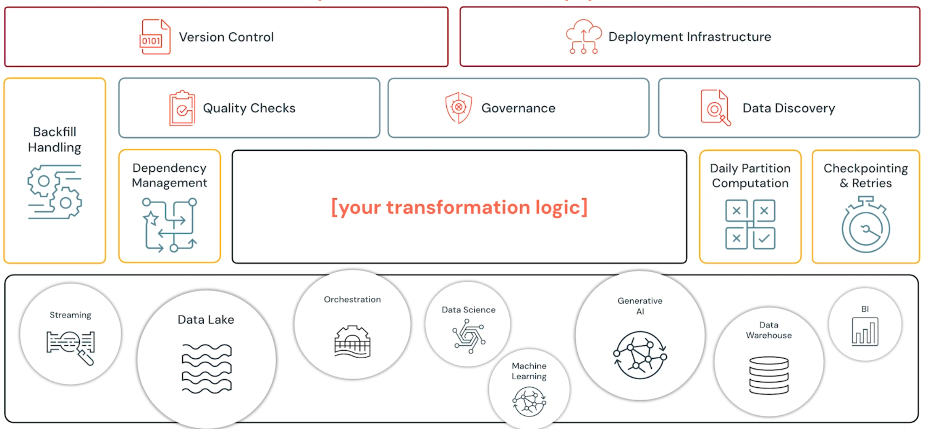
What is a declarative pipeline
What does it solve?

Slide 7
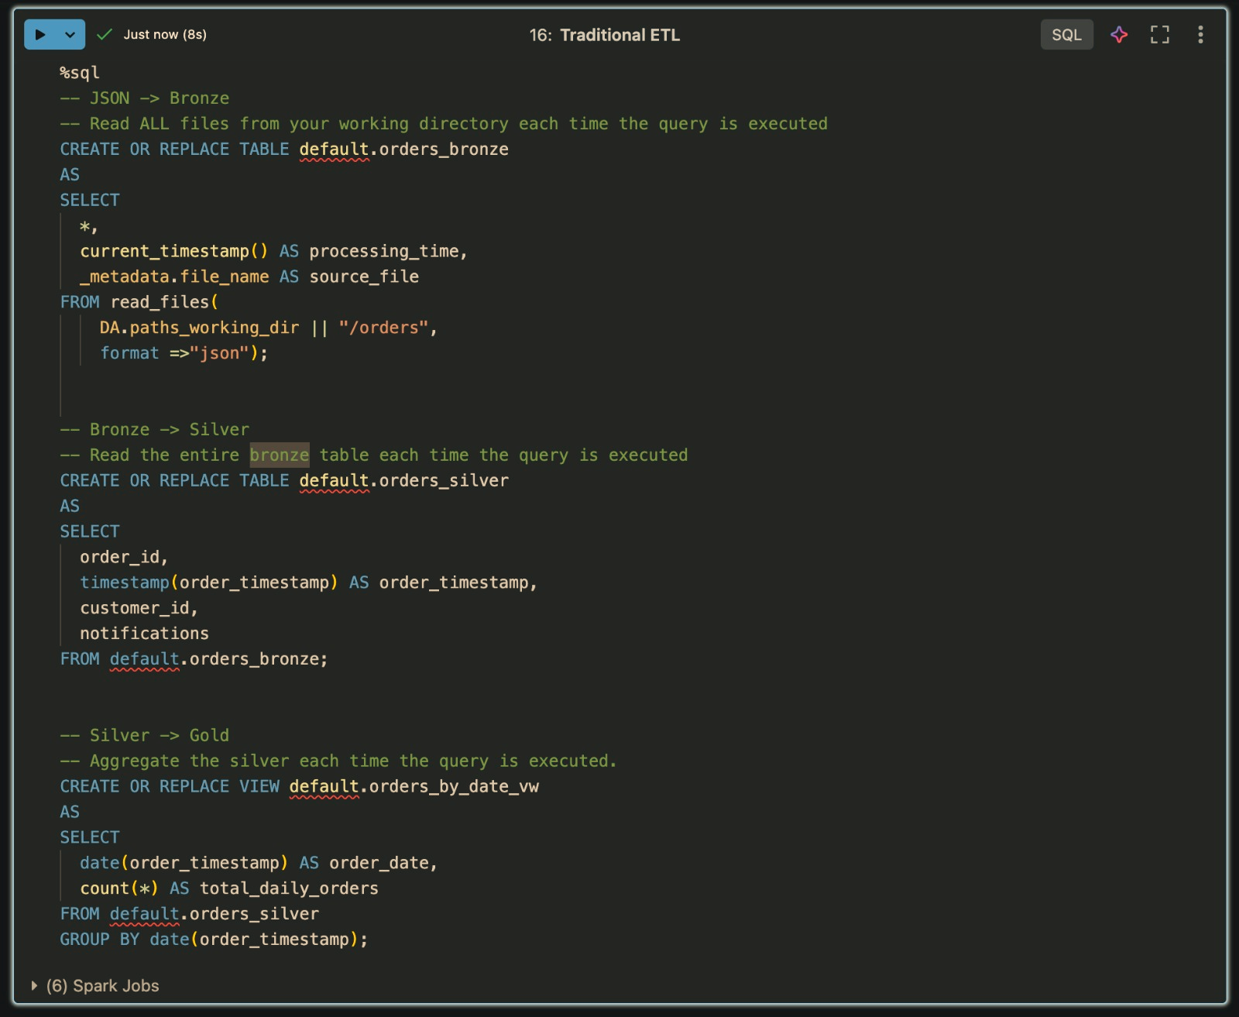
How a data engineer uses Pipelines
For comparison, just tables

Slide 8
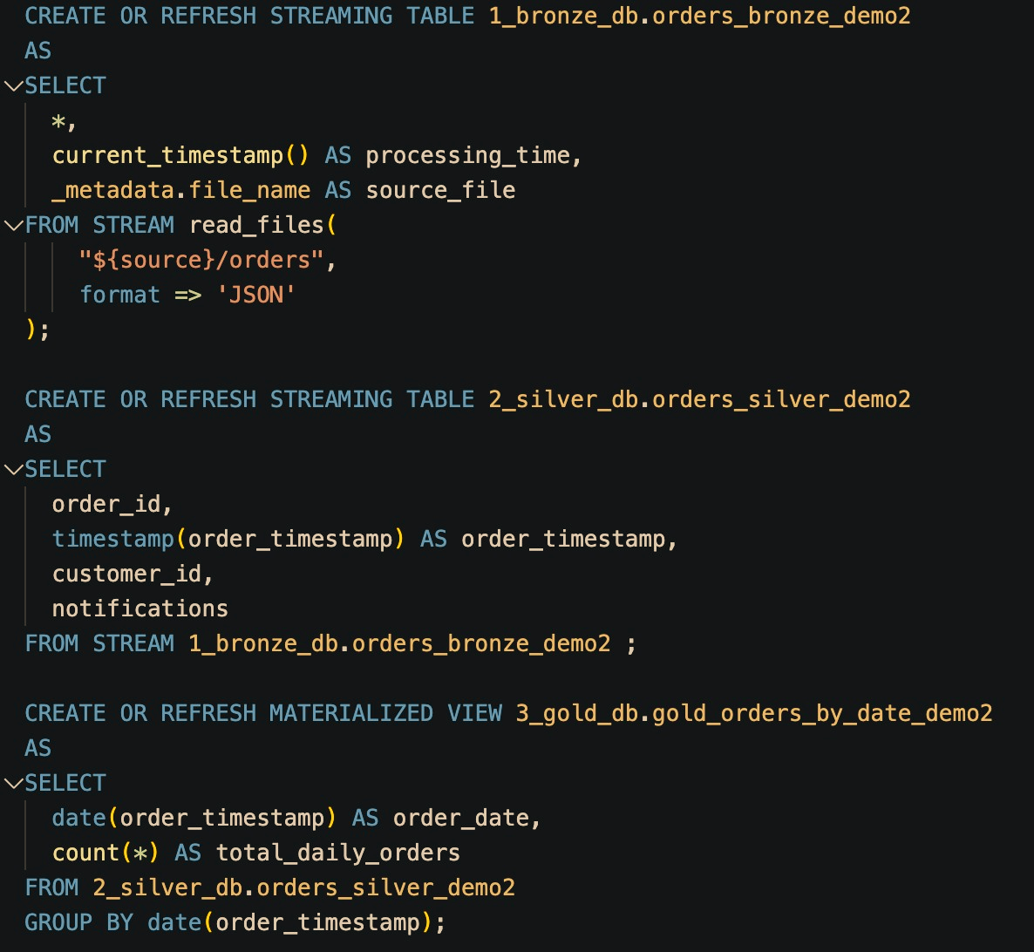
How a data engineer uses Declarative Pipelines
Stop Re‑processing Data — Start Streaming Smarter

Slide 9
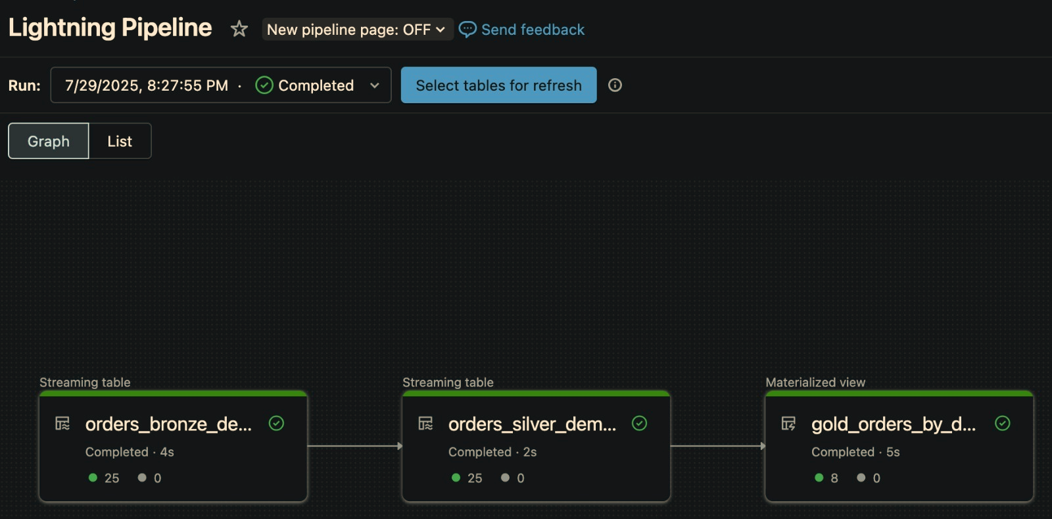
How a data engineer uses Declarative Pipelines
Then we have graphs, descriptions, configuration…

Slide 10
Real benefits for data engineers
Declarative pipelines, what’s the big deal?
You declare what your pipeline should do, not how to do it.
Lakeflow auto-manages orchestration, dependencies, optimization…
Supports both batch & streaming logic in unified SQL or Python
Built-in optimizations and recovery with serverless compute

Slide 11









